Slide 1

Recruitment and Training system
Group 2 Team 5
Zaki 30010702 Kerri–Anne 30014123
Saleh 30001162 Hossam 30008722 Luke 18030327

Slide 2


OBJECTIVES
1- communication
2- Collaboration
3- Portfolio
4- Repository
5- Documentation
6- GUI (UML)
7- Future Changes
8- MyLabProgramming
Zaki 30010702

Slide 3

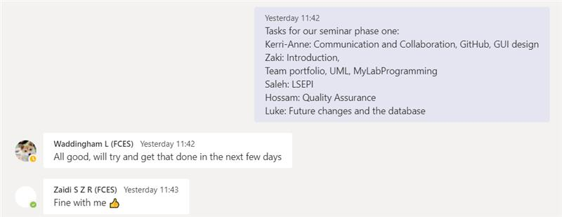
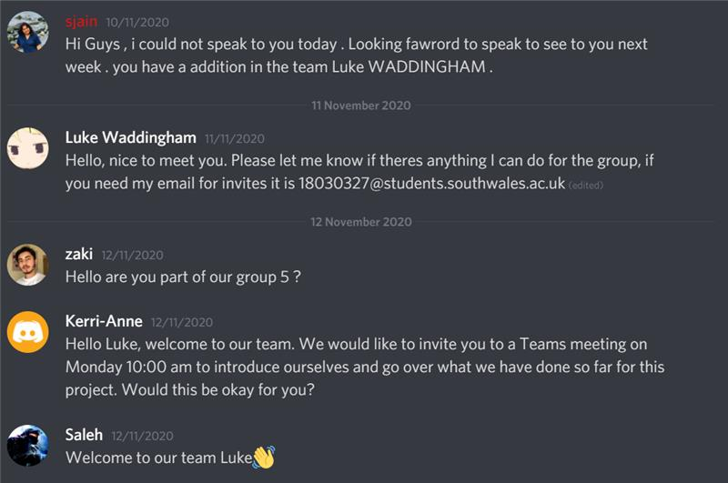
1-Communication
Our group mainly communicates through Microsoft Teams as we felt it the easiest to understand and use. We hold two meeting a week to discuss group work and individual progress.
Discord will also be used as a means of fast communication between us and our lecturer.
Kerri–Anne 30014123

Slide 4
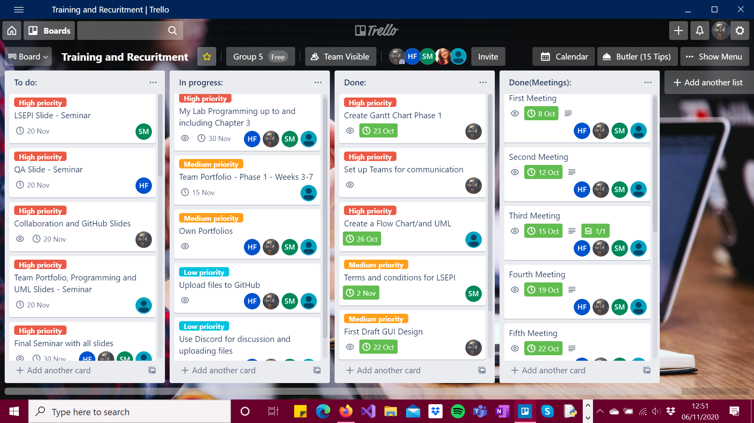
2- Collaboration
To organise and prioritise workload our team has decided to use Trello.
Work division is divided between team members based on individual tasks. Each team member can view task deadlines and update boards.
Kerri–Anne 30014123

Slide 5
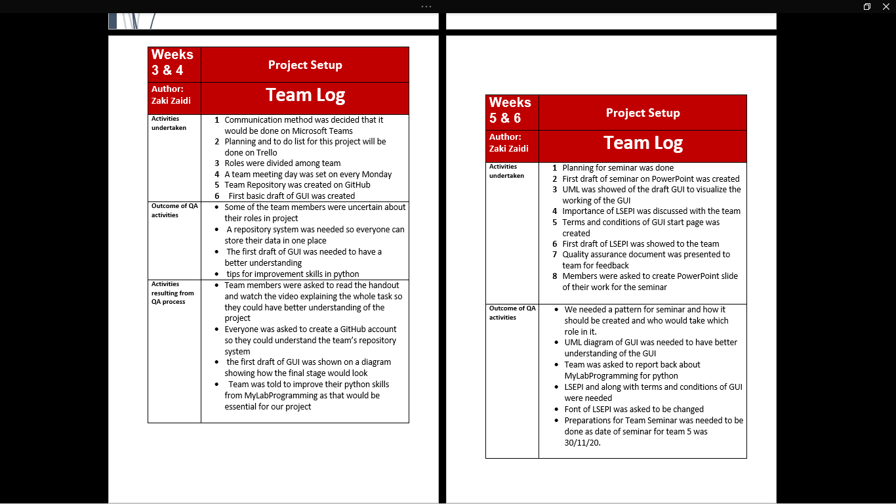
3- Portfolio
Portfolio plays a vital role in this phase it is used for :
1- Team Log was maintained to keep track of the team's progress
2- Team Portfolio was divided between the team for 4 week each while others write their personal portfolio
3- All outcome of Questions and Answers of Team meetings were noted in the portfolio which helped us progress into the further weeks
Zaki 30010702

Slide 6
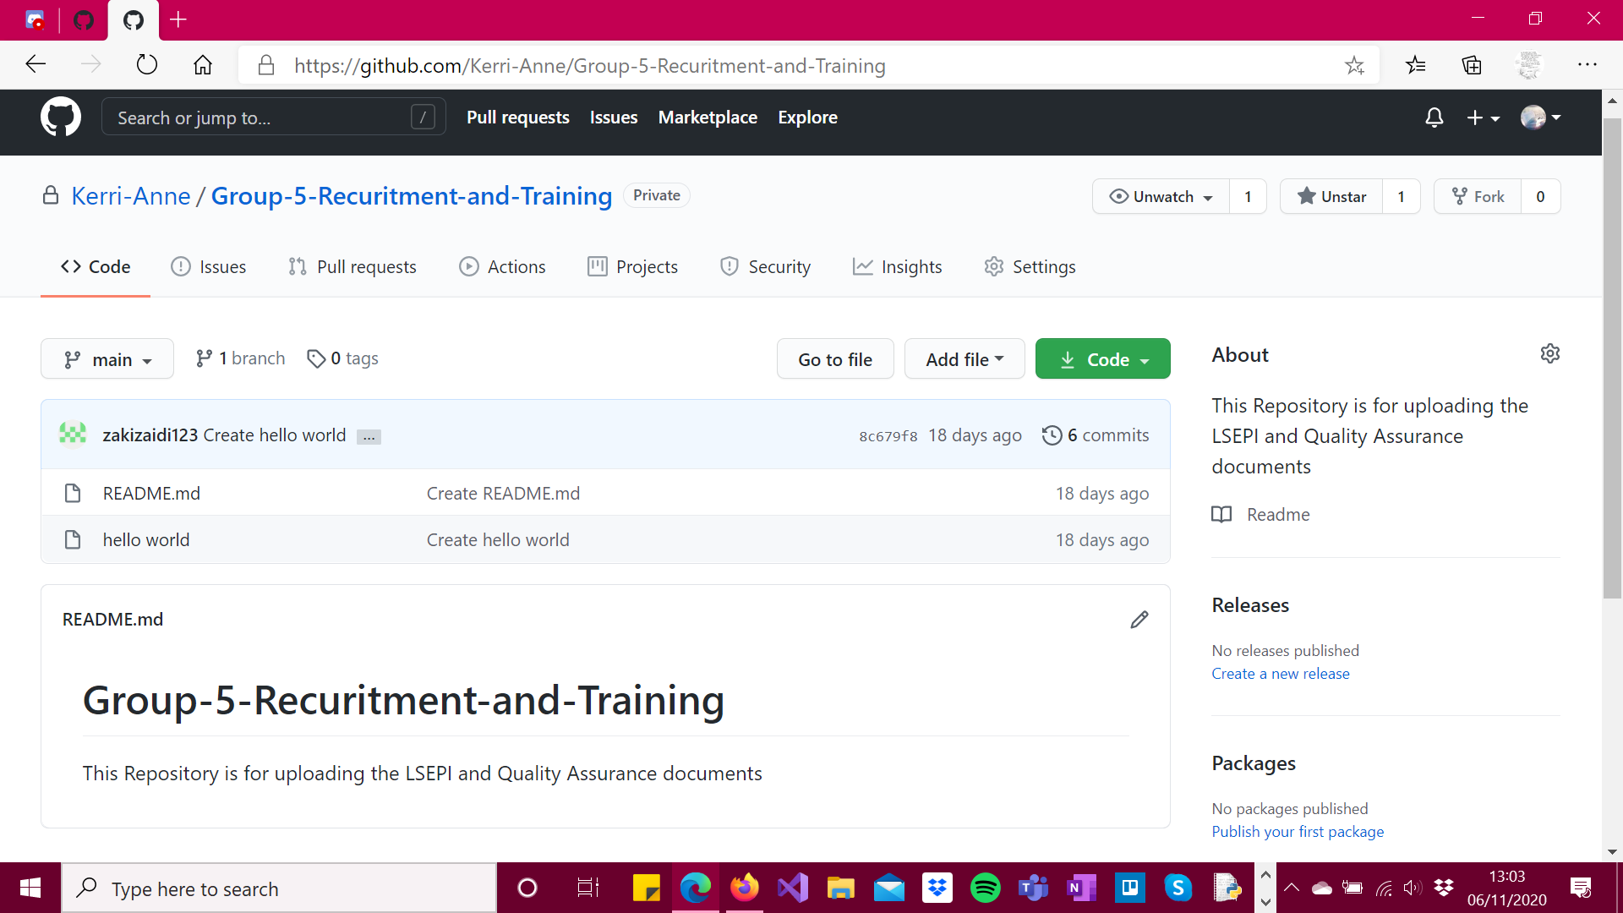

Kerri–Anne 30014123
4- Repository
All team members set up their own GitHub account.
On my account, I created our team repository and added all team members; so that we can all access and upload documents.

Slide 7
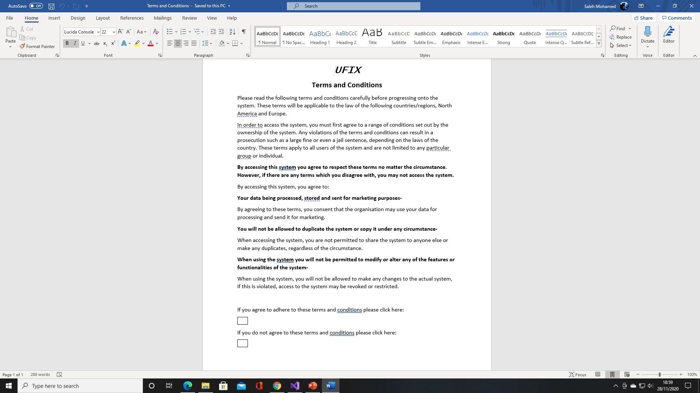
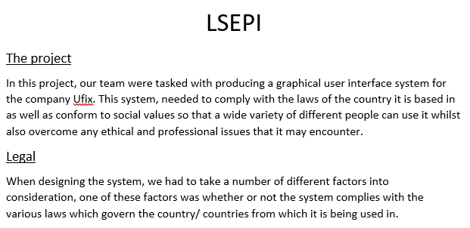
5- Documentation
Saleh 30001162
LSEPI + T&C
There are 2 main types of Documentation included in this Project which are :
1- LSEPI + Terms and Conditions
2- Quality Assurance Report
One of the requirements of the project was to create a documentation which discusses the legal, social, ethical and professional issues which the project may have.
This revolved around areas such as whether or not the project complied with the law of the country it is based in
as well as various other aspects.
In addition, the documentation also needed to contain the terms and conditions to ensure that all users were willing to comply to various requirements such as their data being processed in order to use the system.

Slide 8
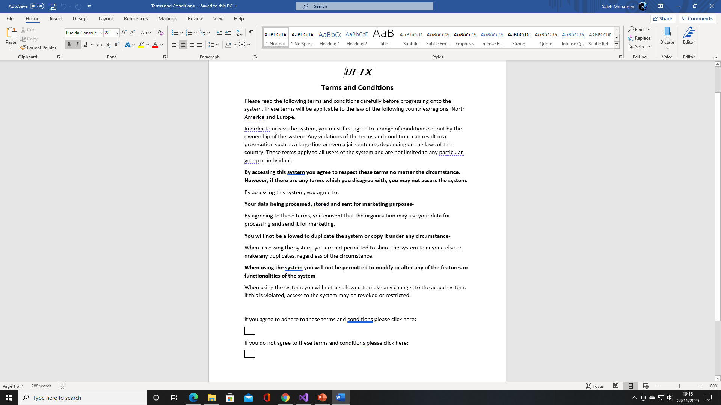
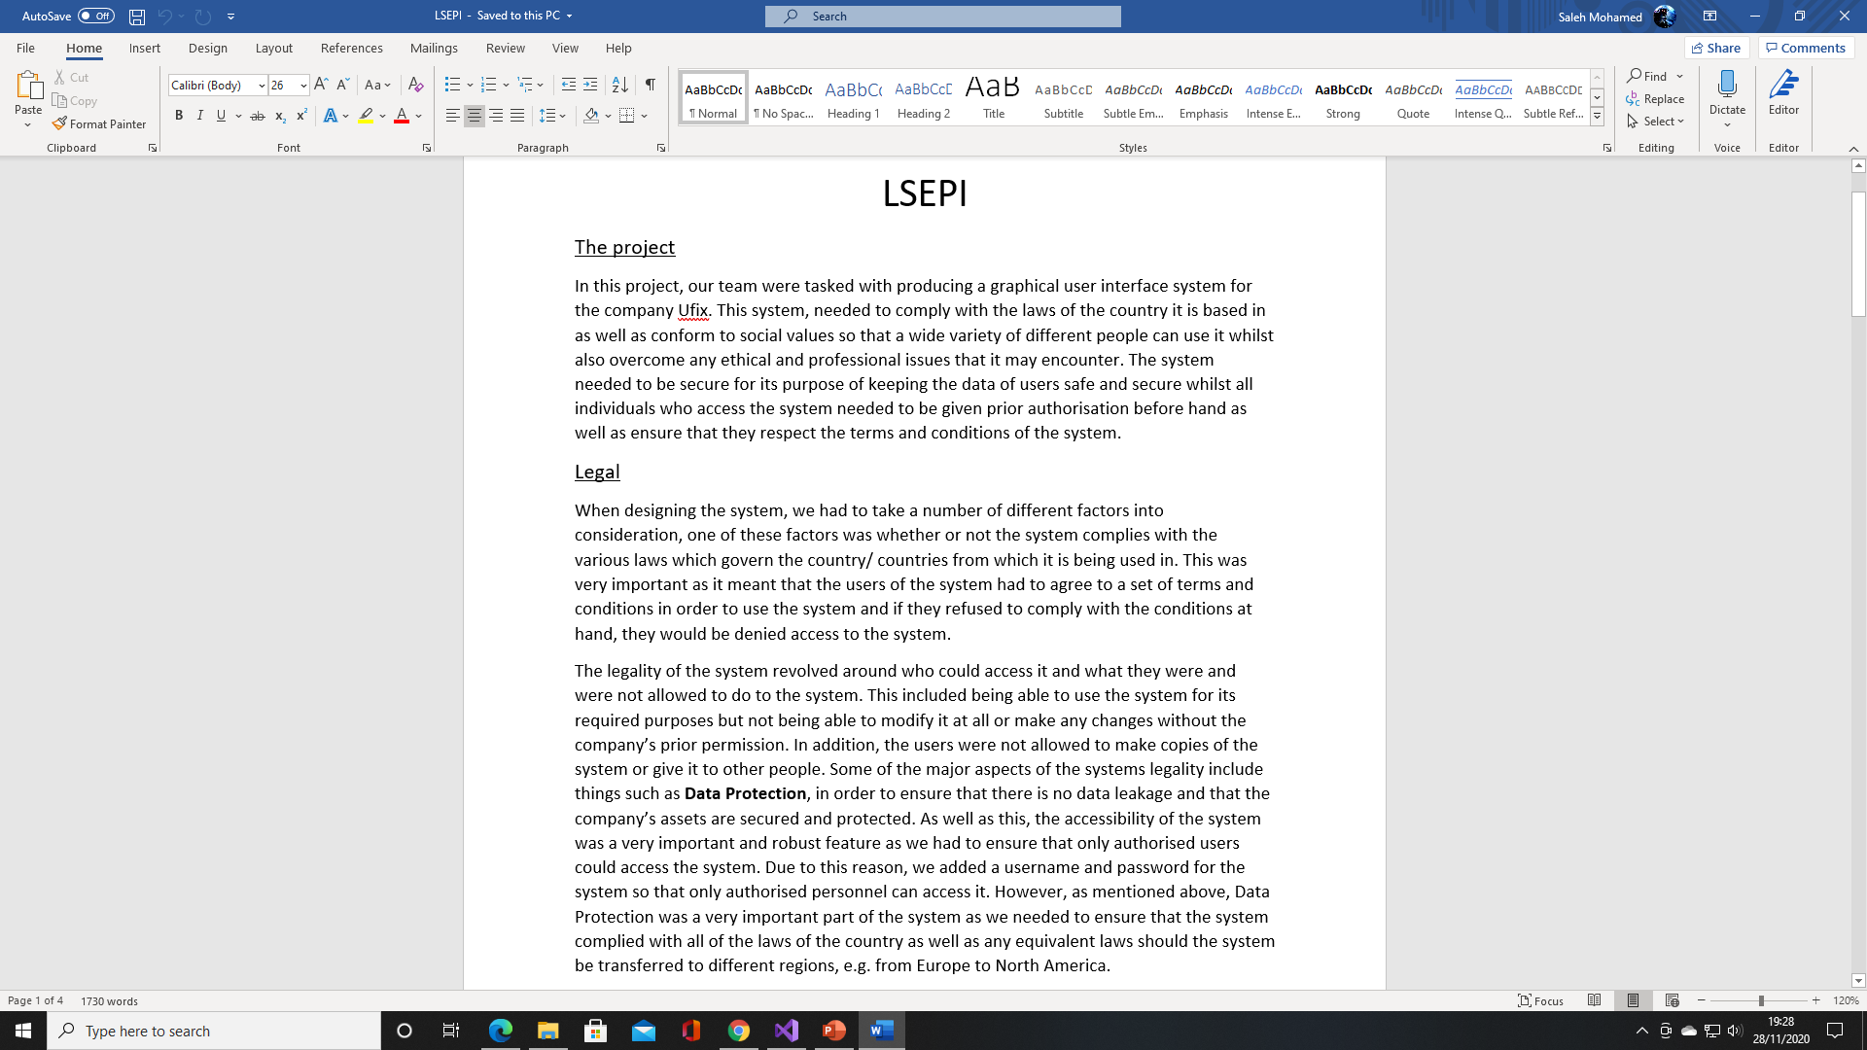
LSEPI + T&C Continued…..
For the terms and conditions, the users would need to
agree to a variety of different requirements such as their
data being processed and potentially used for marketing
purposes.
Moreover, they would need to agree to not making any
copies of the current system and would also have to agree to not making any modifications to the system. If any of these requirements are violated, the users could be prosecuted by the law of the country they are based in.
For the LSEPI Documentation, the legal aspects included whether or not the system complied with current laws in the country/ countries it is based in. The social aspects of the system revolved around how easy the system was to use and how eye-catching and appealing it is for users.
Finally, the ethical and professional aspects of the system revolved around how the group communicated throughout the development of this project.

Slide 9

Hossam 30008722
Quality Assurance Report
Quality Assurance is meeting the requirement, expectation, and needs of the customer is free from the defects, lacks and substantial variants. There are standards needs to follow to satisfy the customer requirements.
Most businesses utilize some form of quality assurance in production, from manufacturers of consumer packaged goods to software development companies.
Some companies may even establish a quality assurance department with employees that focus solely on quality assurance.

Slide 10
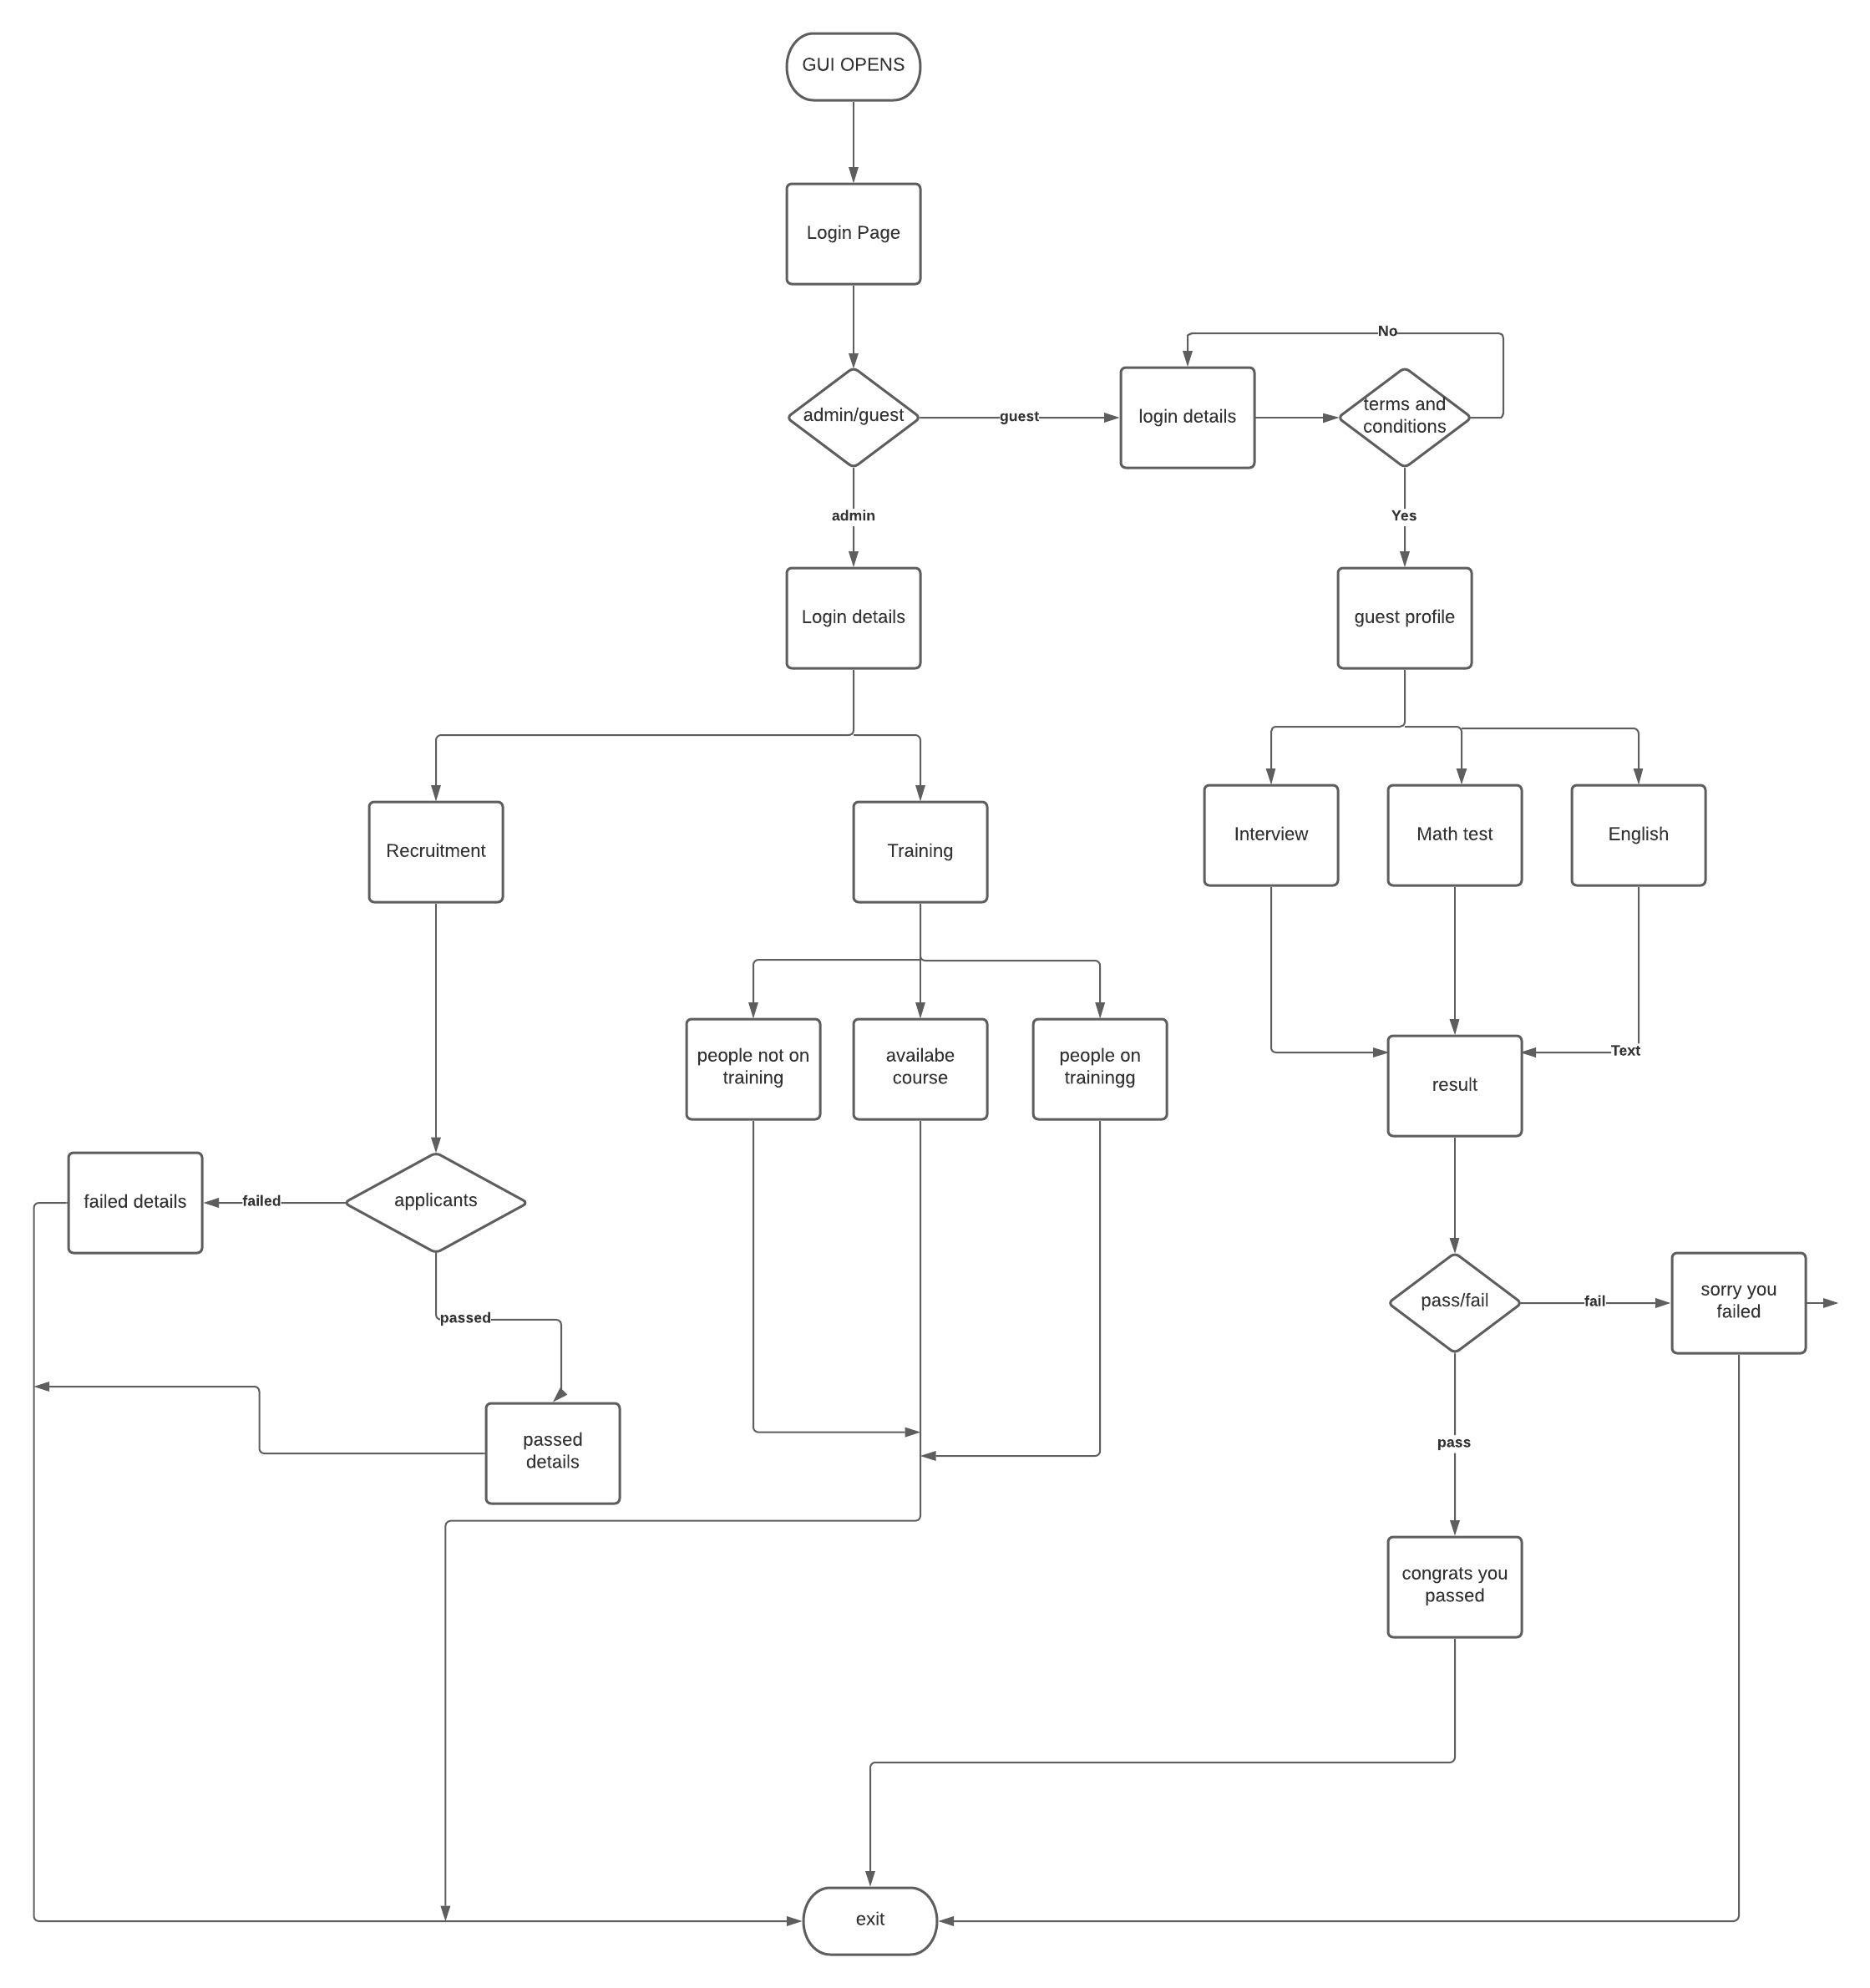
6- GUI (UML)
UML of GUI was created for the team to have a better understanding of the project so the design could be created
Zaki 30010702

Slide 11
6- GUI Design
Login
Main page
Guest
Guest
Guest
Admin
Username
Interview
Password
Math test
English test
Drop downs for selecting how the user can log in.
Terms and conditions
Users can sign into our system as a Guest or Admin.
Guests need to agree to our Terms and Conditions before being allowed entry to the system.
They will need to complete interview type questions, a Math test and an English test as part of the recruitment process.
Kerri–Anne 30014123

Slide 12
Admin
Admin
Recruitment
Admin
Training
Username
No of Applications
52
Courses Available
25
Password
People on training
105
Passed Interview
8
Failed Interview
People not on training
40
44
Email result
Admin can see who met the overall pass rate of these three tests and invite them to join the company as an employee. An email will be sent either way to the user informing them of the good or bad news.
Admin can also view and apply for training.
Kerri–Anne 30014123

Slide 13



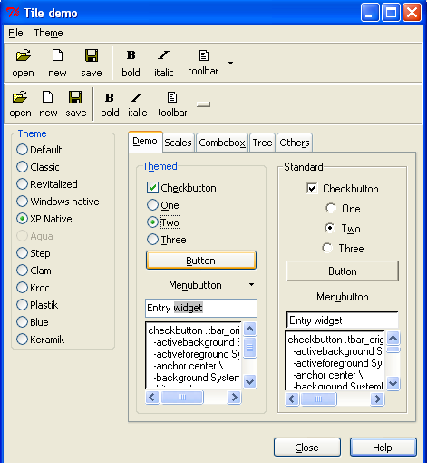
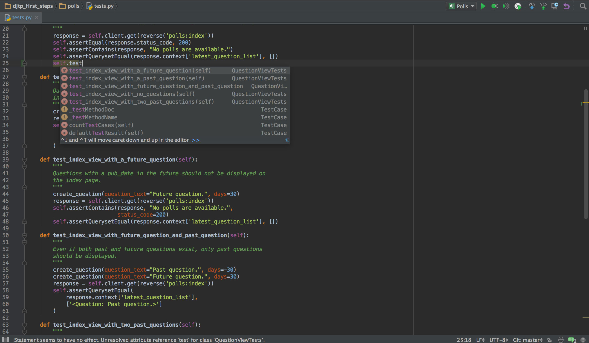
7- Future Changes
Specifically created for Python
Error-checking
Collaboration tools
SQLite library built in (PySQLite)
Cross-platform
All visual elements are derived from the user operating system
Considered one of the most lightweight and relatively painless frameworks to exist
Luke 18030327

Slide 14
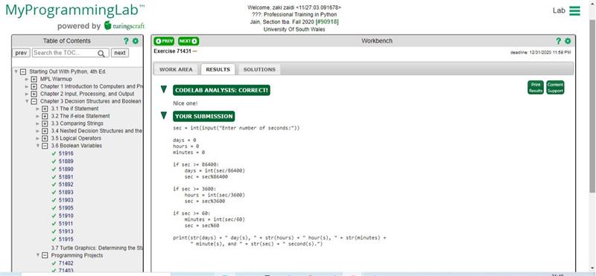

8-MyLabProgramming
Our Team made sure that we our working on MyLabProgramming as well as that would help us in building the actual GUI
We helped each other out when ever anyone needed any help
Zaki 30010702

Slide 15
Thankyou for Listening
Group 2 Team 5

